Slide 1
Mechanisms in Chronic Pain Treatment
Willingness and Engagement
to experience pain and discomfort
in what matters
Kevin E. Vowles, Ph.D.
University of New Mexico
Association for Contextual Behavioral Science
June 2014

Slide 2
One assumes the following
Treatment success very rarely looks like this:

Slide 4

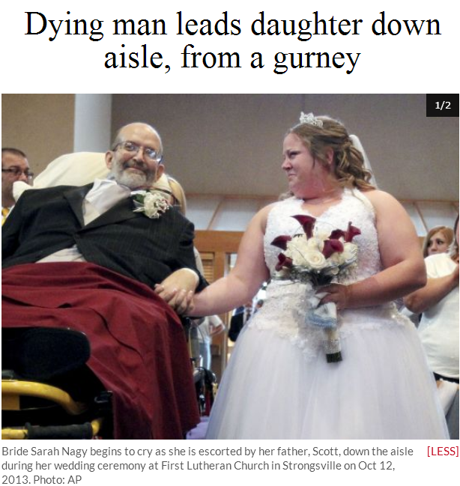


Slide 5
In brief, the ACT model assumes that “just accepting it” is insufficient.
Behavior that demonstrates “acceptance” is behavior done in the pursuit of something deemed to be of greater importance than pain.

Slide 6
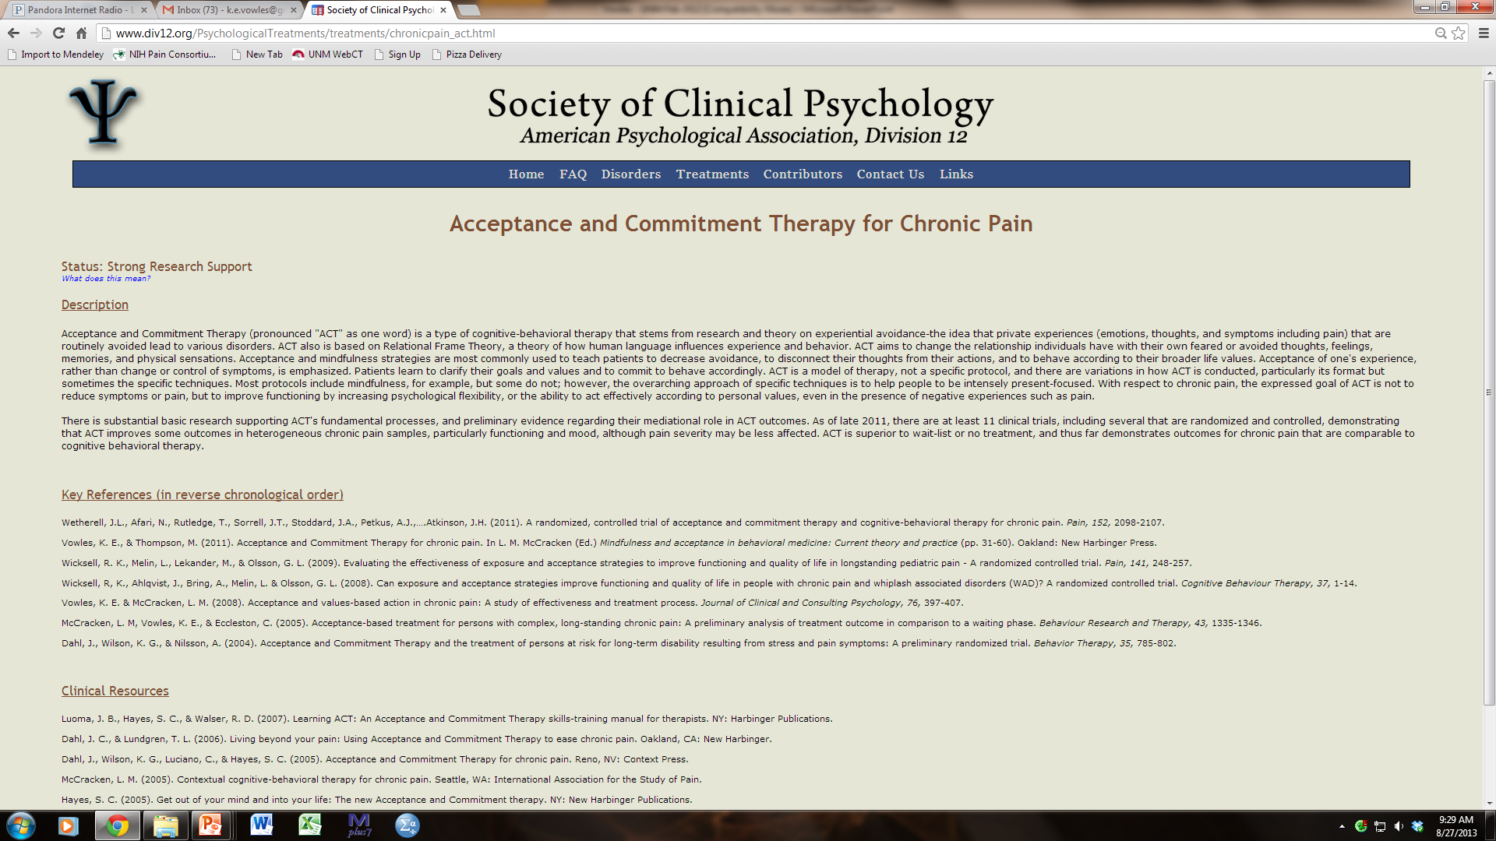
Does it work?
“To meet this standard, well-designed studies conducted by independent investigators must converge to support a treatment’s efficacy.”

Slide 7
What about success from failure?
Requires that we define success in a way that is quantifiable.
If we define success, it could allow us to determine change in processes required for success.

Slide 8
The treatment program:
Interdisciplinary program of ACT
Intended for highly disabled or distressed individuals who are either not appropriate for lesser intensive treatments or for whom these treatments have already failed
Duration: ~6.5 hrs daily for 4 weeks, 2 days/wk
*Outcomes detailed in: Vowles, Witkiewitz, Sowden, & Ashworth, 2014, Journal of Pain

Slide 9
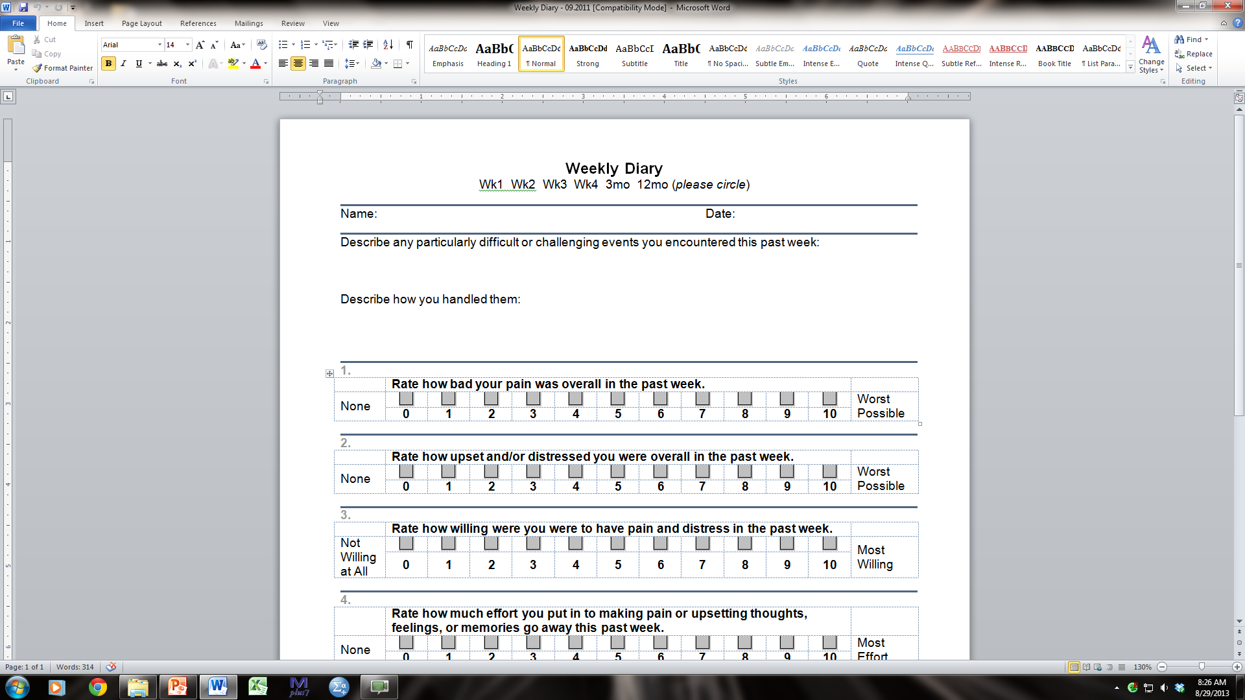
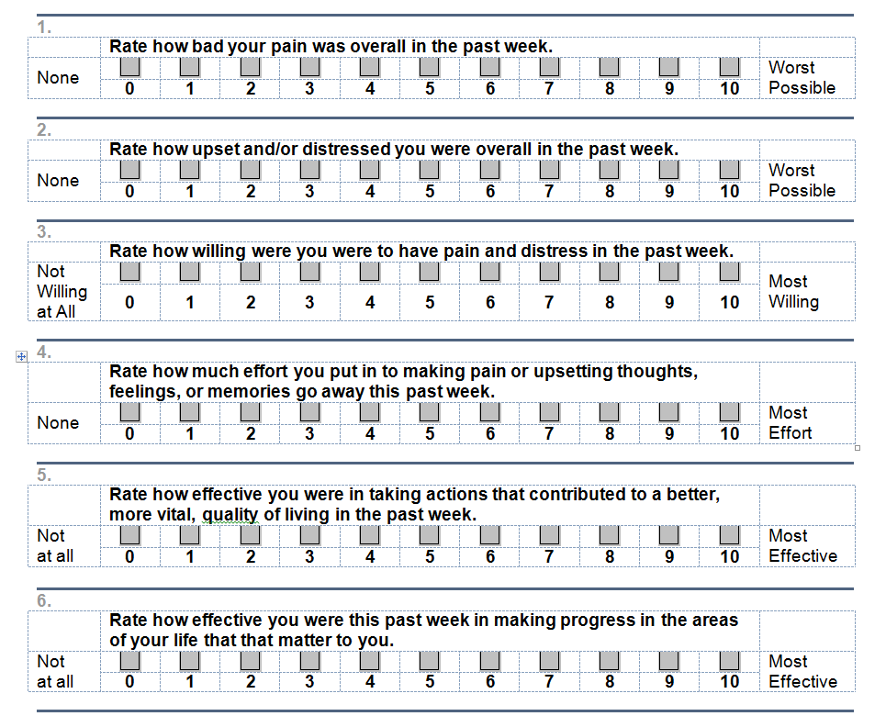
Pain
Unwillingness
Valued Engagement

Slide 10
Success criteria:
  Reliable Change (RC) in disability at follow-up (Sickness Impact Profile reduction of > 0.12; possible range from 0 to 1.0)
Change criteria:
  + 2 or +33% (whichever was greater).
Participants
    21 treatment consecutive treatment completers, who also provided weekly diary data and 3 month follow-up information.
Vowles, Fink, & Cohen, in press;
Journal of Contextual Behavioral Science

Slide 11
Questions
Does treatment success require (is it consistently associated) with a:
  decrease in Unwillingness AND increase in Engagement?
  decrease in Pain Intensity?

Slide 14
3 mo. Outcomes:
Disability: Reliably improved
Med Visits in prev 3 months : From 5 to 0

Slide 15
3 mo. Outcomes:
Disability: Reliably improved
Med Visits in prev 3 months : From 15 to 2

Slide 16
3 mo. Outcomes:
Disability: Not reliably improved
Med Visits in prev 3 months : From 0 to 0

Slide 17

Overall findings

Slide 18
Reliable Change on the SIP
10 of 21 patients (47.6%) evidenced reliable change on the SIP.
Average change:
No RC: -.03 (+ .04)
Yes RC improved: -.17 (+ .06)
Minimum
Change
Maximum
Change

Slide 19
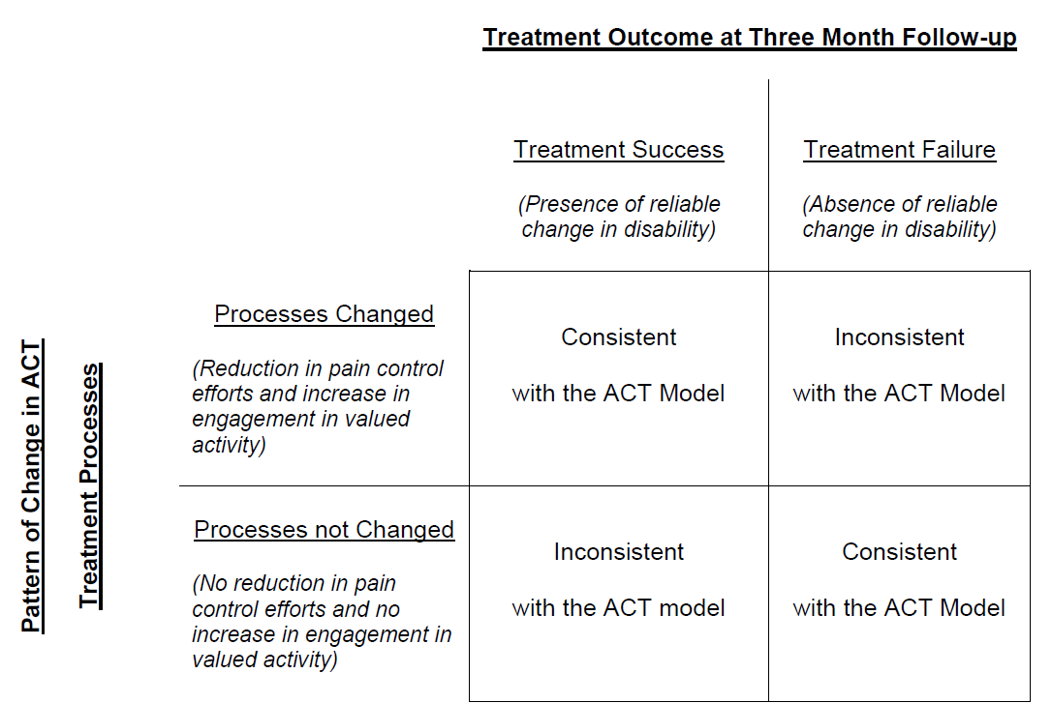
Evaluation of Change Requirements

Slide 20
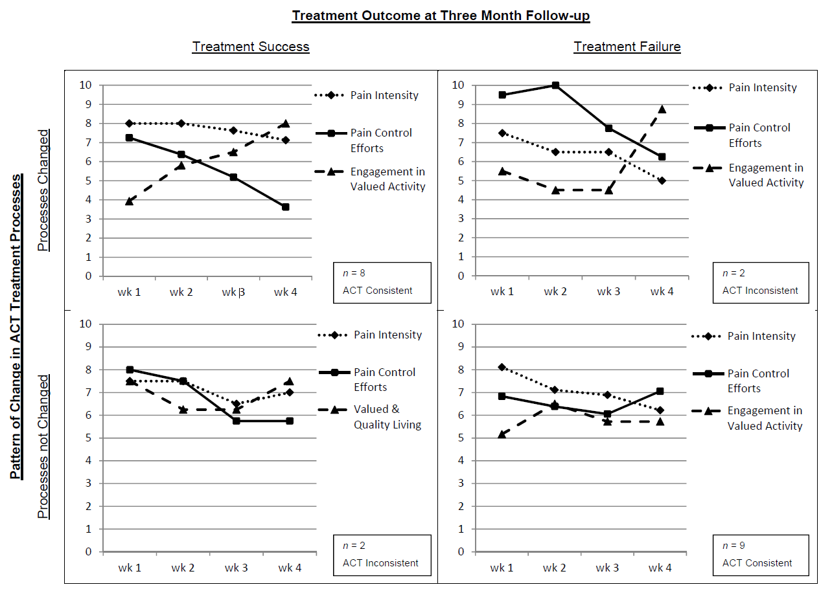

Slide 21
Change in Pain?
 | Decreased Pain | Same Pain | Worse Pain
RC Improved | 2 (9.5%) | 7 (33.3%) | 1 (4.8%)
No RC | 5 (23.8%) | 6 (28.6%) | --

Slide 22
Conclusions
These preliminary findings suggest some potential prerequisites for treatment success within ACT.
If the results are borne out, it may allow us the opportunity to:
  more clearly target them within our interventions
  communicate their importance to patients and providers
  and, ideally, strengthen our outcomes.

Slide 23

Thanks for your attention.
Acknowledgements and thanks:
  UK
    Julie Ashworth
    Chris Eccleston
    Gail Sowden
    Lance McCracken
  Sweden
    Rikard Wicksell
USA
  Robert Bailey
  Lindsey Cohen
  Brandi Fink
  Mindy McEntee
  Katie Witkiewitz
Questions?
  k.e.vowles@gmail.com

